Slide 1

GAME DEV WITH ALLEGRO 5
Getting Started (Second Way)

Slide 2
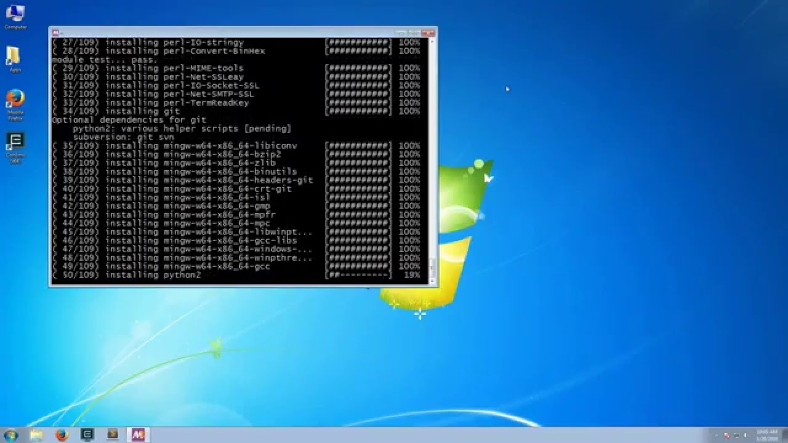
Making Use of MSYS2
Open up MSYS2 (32 or 64 bit)
Type in pacman -S pkg-config
This will install Package Config
Type in pacman -S mingw-w64-x86_64-allegro
This will install Allegro 5
Type in pacman -S mingw-w64-x86_64-dumb mingw-w64-x86_64-flac mingw-w64-x86_64-freetype mingw-w64-x86_64-libjpeg-turbo
mingw-w64-x86_64-libpng mingw-w64-x86_64-libvorbis
mingw-w64-x86_64-libwebp mingw-w64-x86_64-openal
mingw-w64-x86_64-opusfile

Slide 3
Download the Pkg-Config plugin for Cevelop
Open up Cevelop
Copy this link:
https://raw.githubusercontent.com/TuononenP/pkg-config.p2/master/site.xml
This link is taken from drprventura channel
Open Cevelop
Go to Help and click on Install New Software
Paste the link next to Work with:
Click Next 2 times
Click the circle next to I accept the terms of the license agreement
Click Finish
Wait for Cevelop to download and install (shown at the bottom right corner)
You will get a Security Warning pop up
Just click Install anyway
Cevelop will prompt you to restart the software once it is done downloading and installing the plugin
Click Restart Now
Wait for Cevelop to restart

Slide 4
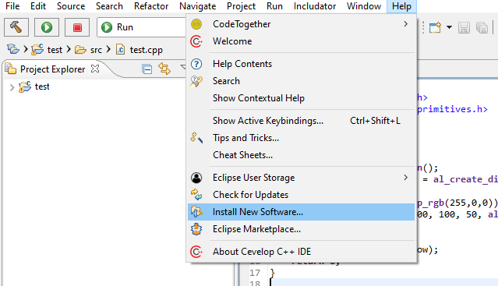
Download the Pkg-Config plugin for Cevelop (Step 3 - 12)

Slide 5
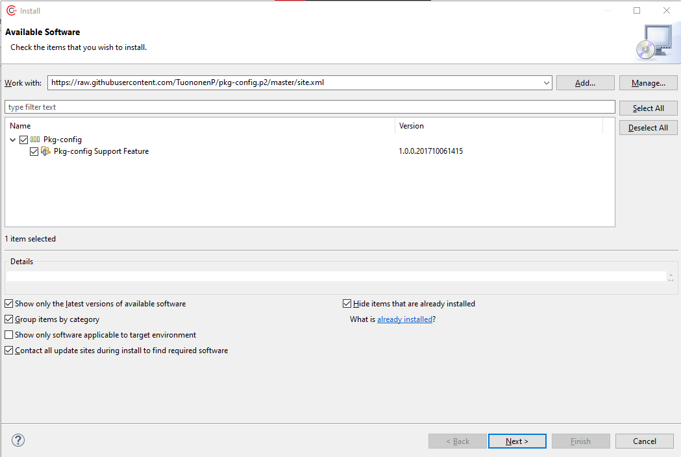
Download the Pkg-Config plugin for Cevelop (Step 3 - 12)

Slide 6
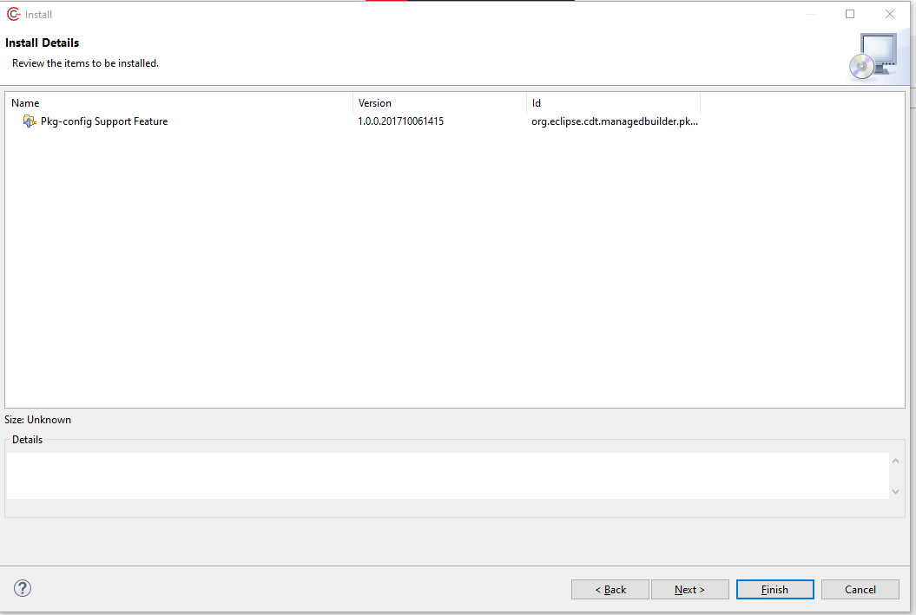
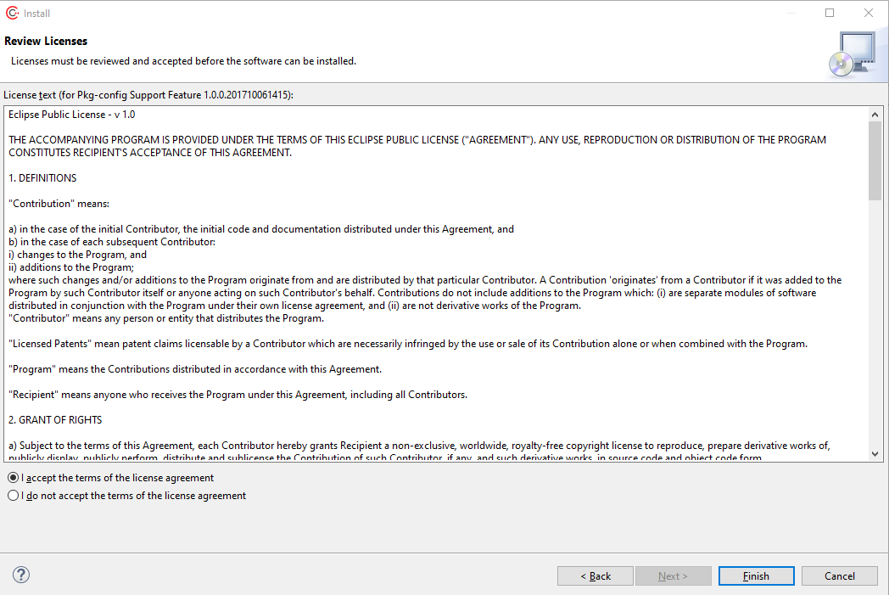
Download the Pkg-Config plugin for Cevelop (Step 3 - 12)

Slide 7
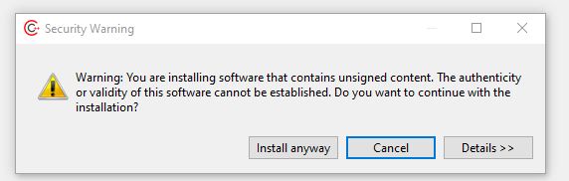
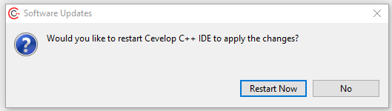
Download the Pkg-Config plugin for Cevelop (Step 3 - 12)

Slide 8
Making use of Pkg-Config (After Cevelop Restarted)
Create a Project
Go to Project and go to Properties
Expand C/C++ Build
Click on the Setting
Click on the Pkg-config tab
Click on the Advanced button
Click on radio button for custom
Click Browse
Go to C:\msys64\mingw64\bin\pkg-config.exe
Click Ok
It will show you a list of libraries on the table
Check allegro-5, allegro_acodec-5, allegro_color-5, allegro_font-5, allegro_image-5, allegro_primitives-5, allegro_ttf-5
Click Select

Slide 9
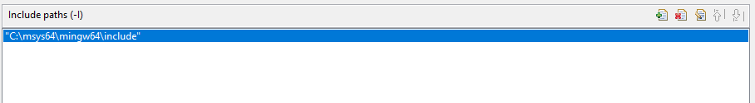
Adding the Library - Include
Go to Tools Settings Tab
Click on Includes under the GCC C++ Compiler
Click on the paper with a plus sign icon
You will get a pop up
Click on the File System
Go to C:\msys64\mingw64\include
click Select Folder
Click Ok

Slide 10
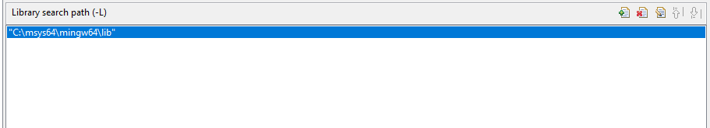
Adding the Library - Library
Click on Libraries under the MinGW C++ Linker
Click on the paper with a plus sign icon
You will get a pop up
Click on the File System
Go to C:\msys64\mingw64\lib
click Select Folder
Click Ok

Slide 11


Making Sure That -IC is correct
Click on Miscellaneous under the GCC C++ Compiler
make sure it says -IC:/msys64/mingw64/include in Other flags
You might get -IC:/m y 64/mingw64/include at first so put in the s where the spaces are
Before
After

Slide 12
Sample Code
#include <iostream>
#include <allegro5/allegro.h>
#include <allegro5/allegro_primitives.h>
using namespace std;
int main() {
al_init();
al_init_primitives_addon();
ALLEGRO_DISPLAY *window = al_create_display(500, 500);
al_clear_to_color(al_map_rgb(255,0,0));
al_draw_filled_circle(100, 100, 50, al_map_rgb(0, 0, 0));
al_flip_display();
al_rest(5.0);
al_destroy_display(window);
return 0;
}

